Slide 1


Agile Software Development Lifecycle
This presentation explores the Agile software development lifecycle, its principles, stages, frameworks, and implementation.
by Naman Dangi (&) Ashish Shiledar
2405102140003 (&) 2405102130008
CSF (&) BDA

Slide 2
Principles of Agile Development
Flexibility
Customer Focus
Collaboration
Continuous Improvement
Embrace change and adapt to new requirements throughout the development process.
Prioritize customer value and deliver working software frequently to gather feedback.
Foster open communication and teamwork among developers, stakeholders, and customers.
Continuously learn from each iteration and strive to improve the process and product.

Slide 3
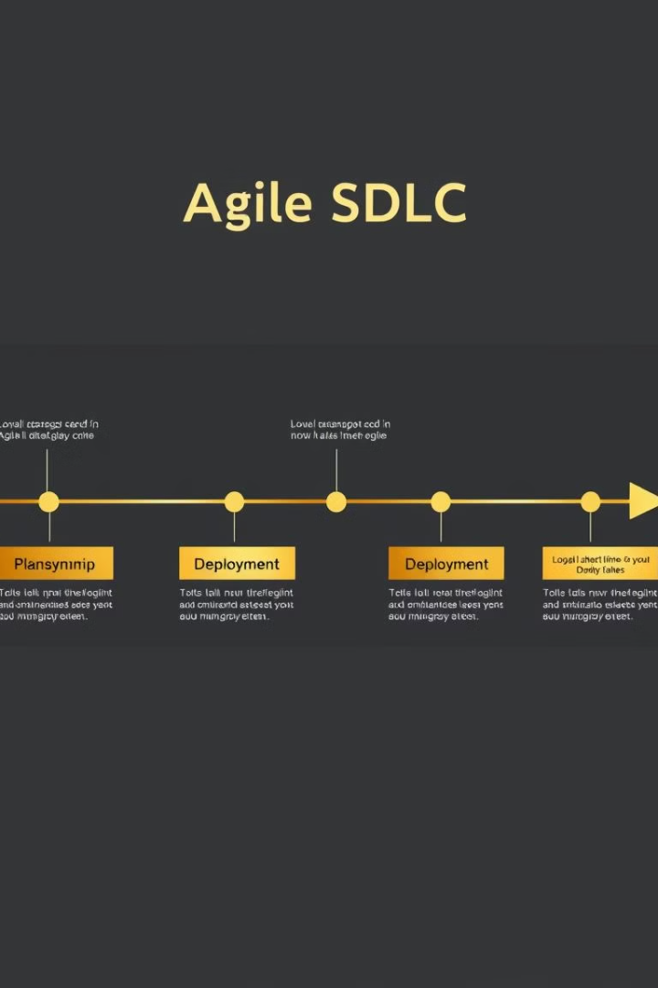
Key Stages of the Agile SDLC
1
Planning
Define the project scope, goals, and initial requirements.
2
Sprints
Break down the project into short, iterative development cycles, with defined goals and deliverables.
3
Reviews
Regularly review progress, gather feedback from stakeholders, and adjust plans as needed.
4
Deployment
Release working software to customers and gather feedback for further improvement.

Slide 4
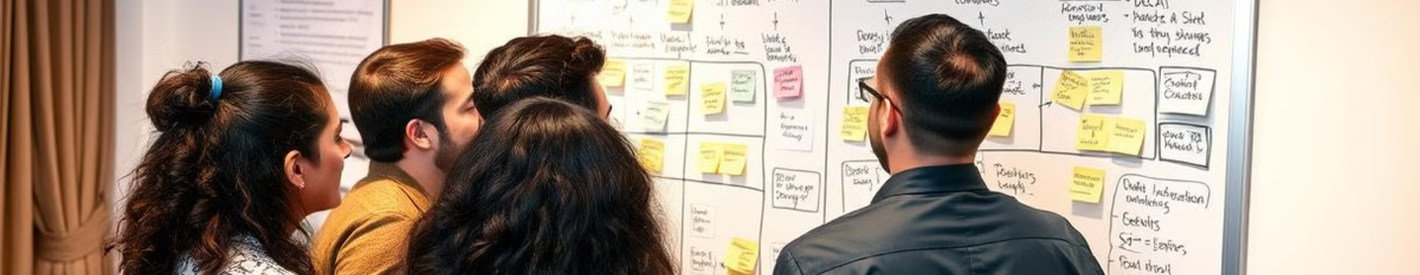
Scrum and Other Agile Frameworks
1
Scrum
2
Kanban
3
XP (Extreme Programming)
A popular framework that emphasizes iterative development, daily stand-up meetings, and sprint reviews.
A framework that focuses on visualizing work flow, limiting work in progress, and continuous improvement.
A framework that emphasizes pair programming, test-driven development, and frequent releases.

Slide 5

Advantages and Challenges of Agile
Advantages
Challenges
Faster time to market
Requires strong team skills
Increased customer satisfaction
Can be difficult to manage large projects
Improved collaboration and communication
May not be suitable for all projects

Slide 6





Implementing Agile in Your Organization
Planning
Training
Identify the right projects, define roles and responsibilities, and choose the appropriate framework.
Provide training to team members on Agile principles, processes, and tools.
Communication
Monitoring
Foster open and frequent communication among team members, stakeholders, and customers.
Continuously monitor progress, identify areas for improvement, and adapt the process as needed.

